Slide 1


Team 21
Smart Parking
Mạc Quang Huy - 20173169
Lê Thái Bảo - 20172966
Nguyễn Đức Bình - 20172970
Lê Quang Huy - 20173173
Hồ Quốc Khánh - 20173191

Slide 2

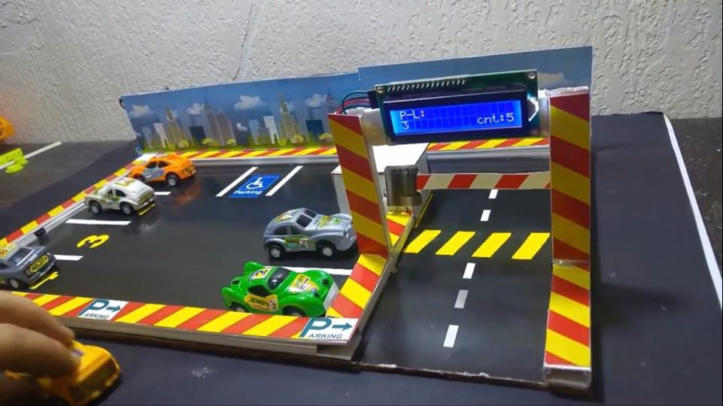
广 告 集 装 箱 出 品
Background and Motivation
Why we are interested in ?
I go shopping at these malls. The problem is that sometimes parking garage is full and I don’t know where to park my car :)

Slide 3


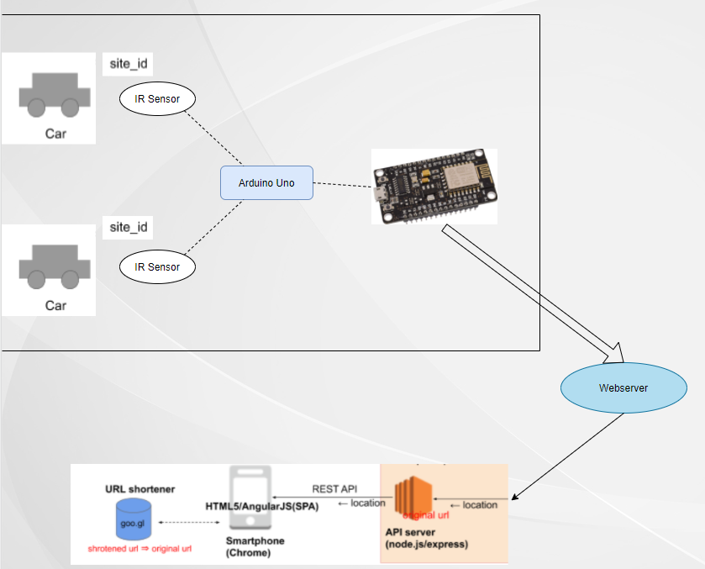
Architecture
Overall architecture

Slide 4

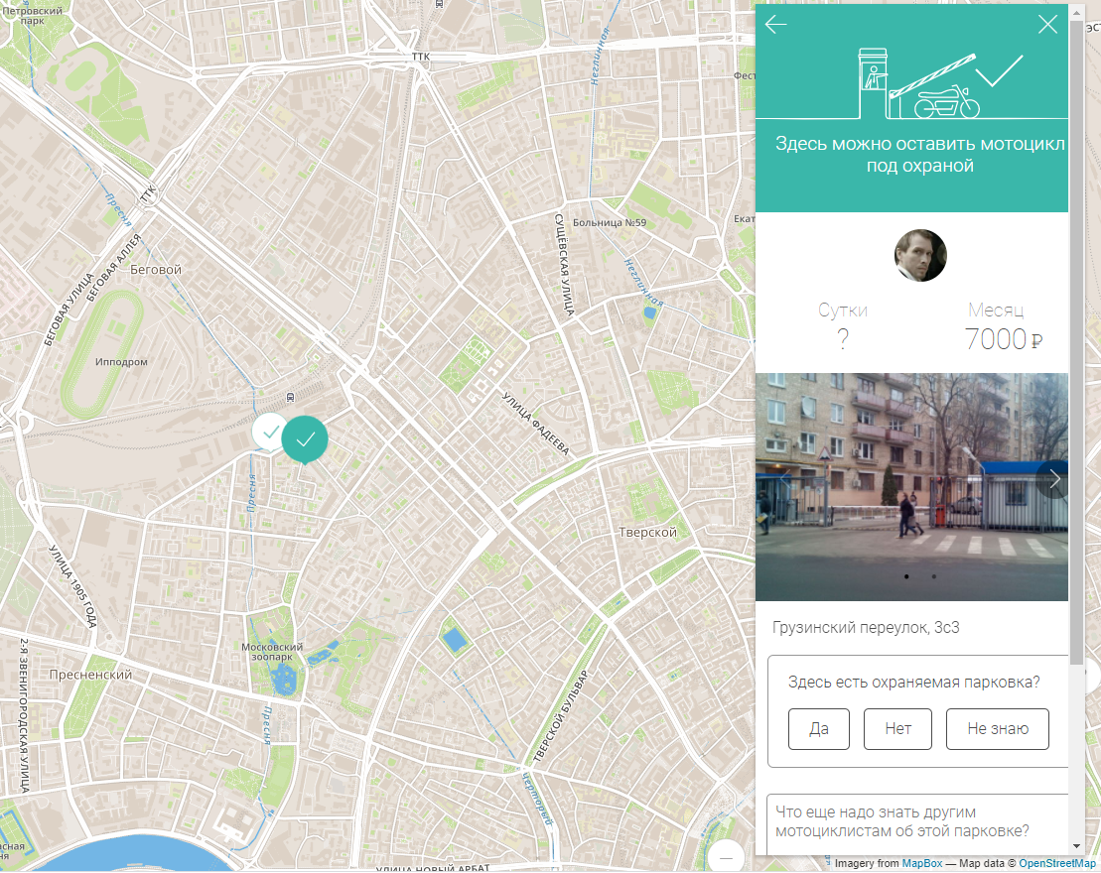
Overview Websize
Show car parks available
For each parking lot, display information of the parking lot: vehicle number, price, time frame,…

Slide 5
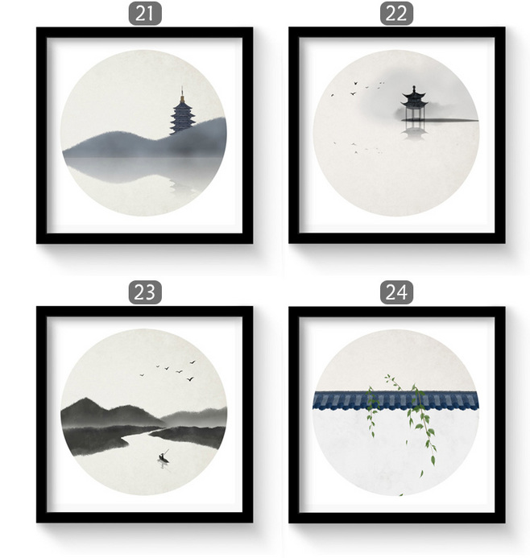
Huy Mac Quang

